Slide 1




The Evolution of Marketing
A Data Explosion
Notes:
And what happened was that very quickly:
You had endless opportunities to try out different channels and tools
There was an endless amount of metrics you suddenly wanted to pay attention to
And we quickly moved from “not having any metrics” to “having too many metrics”
CLICK
In fact, as marketers we were facing this data explosion
And justifying budgets became complicated again

Slide 2

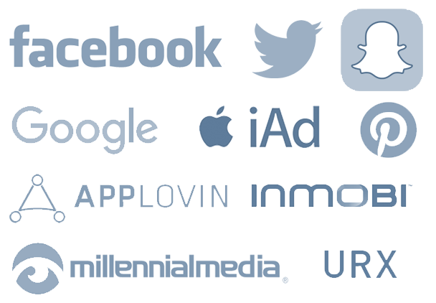

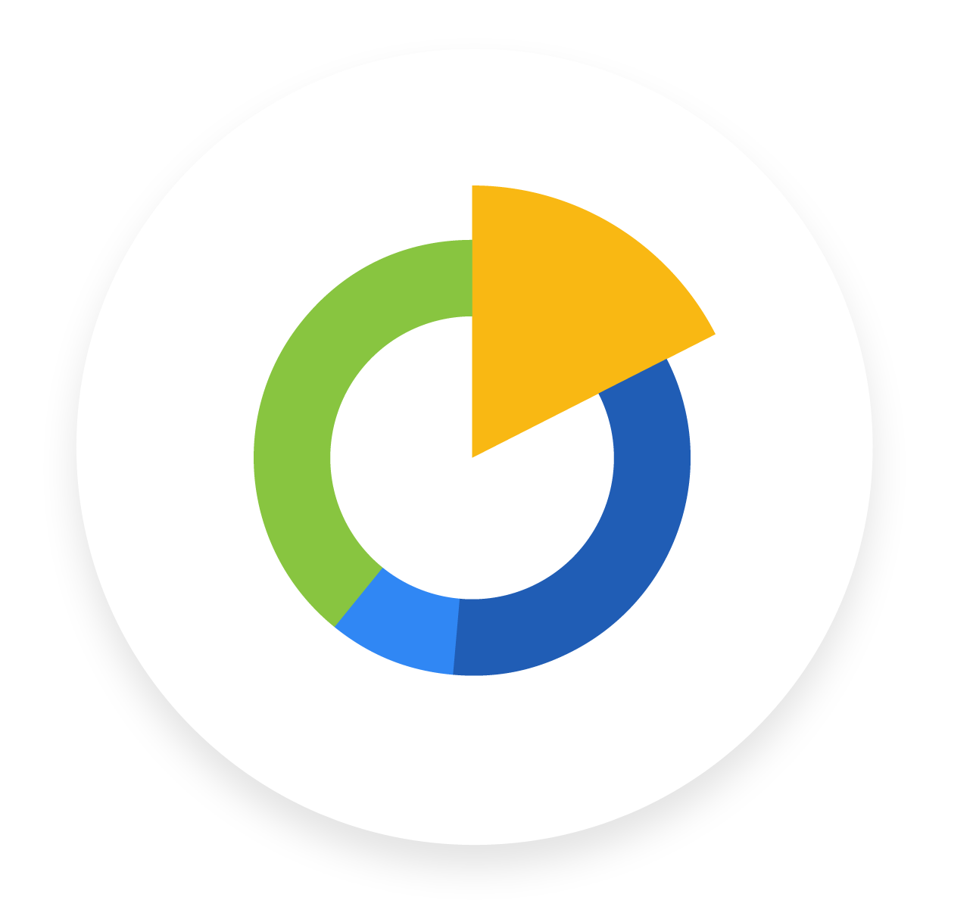
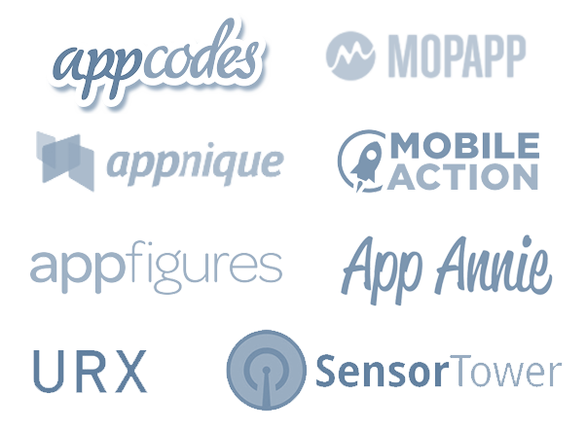

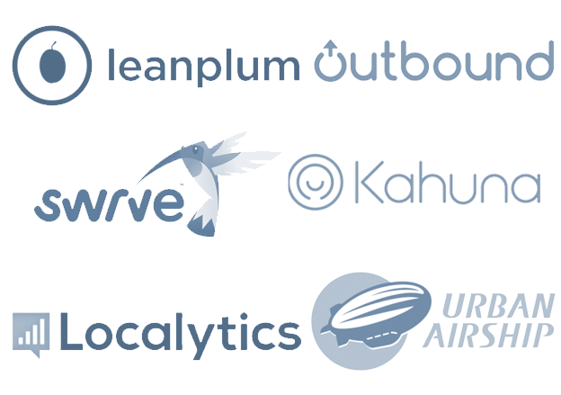
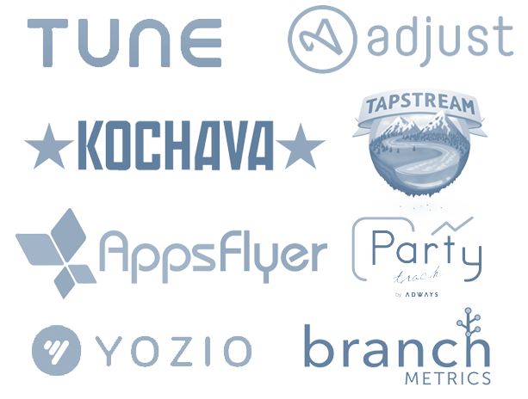


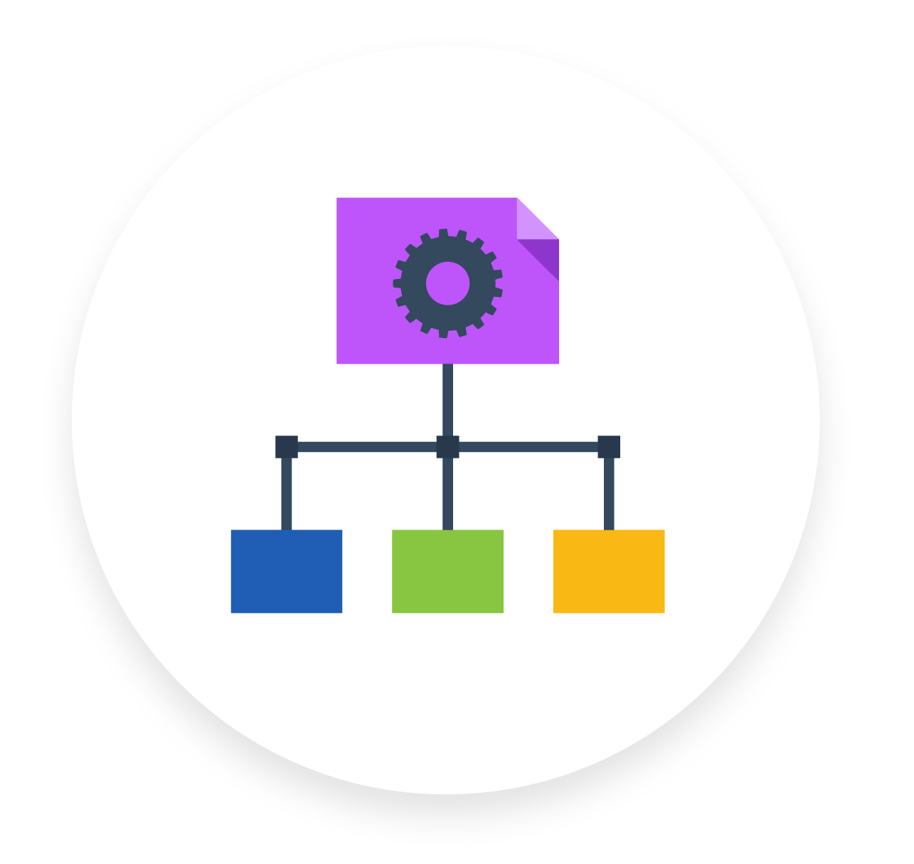
Responsibilities of Mobile Marketing Teams
Paid Acquisition
Analytics
Organic
Acquisition
Lifecycle Management
Attribution Tools
Notes:
And to better explain that, let’s take a look into the responsibilities of marketing teams.
Specifically, I am going to put an emphasis on the mobile marketing ecosystem that Singular primarily caters to.
Mobile marketering teams are in charge of several parts of the customer’s lifecycle:
First off, when you launch a new product, you scope out your analytics requirements and find the right analytics system
Then, you’d like to grow your user base
You can do that through Organic Acquisition
So you optimize your App Store Descriptions, Keywords and Screenshots
Your pages for Search Engines
And if you can get the public’s attention through PR or getting featured by Apple or Google, that can make a big difference
But it’s difficult to optimize for these things, and in most cases, especially in the hyper-competitive mobile app ecosystem, you’ll also need to do a lot of paid acquisition
Which means you now need to start building knowledge and expertise in effectively growing your user-base through paid acquisition
And understanding your CAC v.s. LTV becomes more critical than ever
But as soon as you start bringing on users, you quickly realize it also takes a lot of work to keep them engaged
So you start communicating with your customers in all sorts of forms
You can send them emails, or push notifications and SMS
You can retarget to them based on their behavior
And you can even test, optimize and personalize their experience in the app
All to increase their retention and engagement with your product
And as soon as you start scaling your marketing efforts, you’ll need to be able to verify if your marketing activities even have an impact
The most basic question is whether your acquisition channel is driving highly quality users, which tools like Attribution solve
But you’d also like to know if any of the above methods of engaging your customers are making an impact
And if that’s not enough – you’d like to know what is the right amount of each that you should use (essentially the multi—touch problem)
And then when you actually look into what technical platforms offer these marketing capabilities, you’ll discover there’s insane fragmentation in that market.
*CLICK*
Across every category, you can find so many different platforms that you can use to achieve the specific task at hand. Whether it’s attribution platforms, mobile CRM platforms, ad networks, analytics platforms and more.
Marketers – on average – use 10 to 20 different platforms. And they need to access data from all of these different platforms, all at once, and there’s no simple way of doing that. And this is what causes the data overload.
When we started Singular, we were actually amazed to see how the same problem exists across all verticals and all sizes of companies.

Slide 3



Data Overload
Coping Strategies
HOPE FOR THE BEST
EFFORT IN EXCEL
TRY TO BUILD SOMETHING
Notes:
As we saw from the previous slide, most companies are running into challenges like these.
And the question you guys are probably wondering about, is how do they solve these problems?
In our experience, we’ve witnessed 3 types of strategies:
The first Strategy, which we call “hope for the best”, essentially means trusting your gut over data
Obviously this is far from ideal. Especially in today’s competitive market, where it’s almost mandatory to claim you’re a data oriented company.
As you guys know, it’s practically impossible to build a successful company without being thoughtful about your data, and so we hope it’s a dying trend
The next type of strategy, which is the norm at most companies, is to handle the data overload with People and Excel
Usually, depending on your scale as a company, you’ll have a group of people in the marketing team who are in charge of manually collecting data points from dozens of systems, into various Excel spreadsheets.
The collection process itself is horribly slow and error-prone. But it’s just the beginning.
From there they need to take thousands of types of data points and connect them, to get a clear understanding of the full funnel I described earlier.
What executives realize, is that they can’t get the granularity of data they need, and they must compromise and make decisions based on limited and missing information.
And there’s also a few data-driven companies, who were so unsatisfied with the way things are, that they’ve decided to build a solution for this in-house
What they quickly realized is that there’s an incredible cost associated:
It requires engineers to defocus from the company’s core competence
It requires know-how, and a lot of time
There’s ongoing maintenance involved with fixing issues and building new features
And more often than not, those projects end up going unfinished, or deprecated after a few months of usage
And we wanted to change that, which is why we created Singular, which is an end-to-end solution to the problems we’ve discussed and more.

Slide 4



The Singular Platform
Insights
Automation
Analytics
Notes:
And if we look into the Singular platform at greater detail, we identify 3 main product pillars that are guiding our vision.
The first one is analytics. And that includes the ability to access the data in a unified manner, attribute it, and analyze it from a single location.
The second pillar is automation – where we look at manual and inefficient workflows the marketing team has to perform across the various platforms they work with, and we automate them.
And the third pillar is insights – which is where we utilize the massive amounts of data we collect to make the marketer smarter, and to help him take better decisions.

Slide 5






How we help teams
User
Acquisition
Business Intelligence
Creative
Finance
Executive
Notes:
UA Teams – day to day work becomes sane, optimization, makes their jobs more bearable
BI – access to clean data, ability to help marketing teas
Creative – easier collaboration with the marketing team
Finance – helps them too consolidate their invoices with marketing data
Executive – Resources, cost, results

Slide 6

Analytics will work for people.
(Not people for analytics)

