Slide 1


Erfolgsrezepte für den In-App Wandel
Ragnar Kruse, CEO & Co-Founder, Smaato

Slide 2
Smaato Company Overview
The Leading Global Real-Time Advertising Platform for Mobile Publishers & App Developers
Founded 2005
Demand-Loaded RTB Ad Exchange
& SSP & Ad Server
Part of Spearhead Integrated Marketing Communication Group
220 Employees, 30 Nationalities
60 Product & Engineering
Profitable +50% YoY Growth
90,000+ Publishers & App Developers
450+ DSPs & Demand Partners
91 of Top 100 Ad Age Advertisers
1+ Billion Monthly Uniques
300+ Billion Impressions/Month
San Francisco, CA
New York, NY
Hamburg, Germany
Singapore, SG
Shanghai, China

Slide 3
World Gone Mobile & In-App

Slide 4
Smartphones are omnipresent
The Digital Hub for organizing your life
DIGITAL
HUB

Slide 5

World Gone Mobile
Half of the Global Adult Population Owns a Smartphone Today⁵
7.4
billion
4.8
billion
1.48
billion
2.1
billion
7.4 billion world¹ population
4.8 billion mobile² phone users
1.48 billion smartphones shipped in 2016³
2.1 billion smartphone users in 2016⁴
By 2020, 80% of all adults globally will own a smartphone.
50% of all adults worldwide own a smartphone today.⁵
Wikipedia, March 2016
Statista, 2016
Strategy Analytics, January 2017
eMarketer, April 2016
Economist, February 28, 2015

Slide 6
Mobile is Eating Digital …
Mobile and Desktop Share of Digital Ad Spending, 2013-2019
Digital Marketing
Digital Marketing
Digital Marketing
16%
Mobile
56%
Mobile
71%
Desktop
84%
Desktop
44%
Desktop
29%
2013
2016
2019
Desktop/Laptop
Mobile
Source: eMarketer, February 2017, March 2016

Slide 7
… and In-App is Eating Mobile
In-App vs. Mobile Web Share of Mobile Ad Spending, Q4 2013-Q4 2016
Mobile Advertising
Mobile Advertising
Mobile Advertising
Mobile Advertising
Mobile
35%
15%
22%
Mobile Web
52%
In-App
65%
In-App
78%
In-App
85%
In-App
48%
Q4 2013
Q4 2014
Q4 2015
Q4 2016
In-App
Mobile Web
Source: eMarketer, February 2017, March 2016

Slide 8







The Top 5 Mobile Ad Spending Countries
Top 5 Countries by Mobile Ad Spending (Billions)
with 2017-2018 Expected Market Growth
USA
CHINA
UK
JAPAN
GERMANY
$57.1
+20%
$37.9
+33%
$10.0
+22%
$7.4
+25%
$4.4
+25%

Slide 9
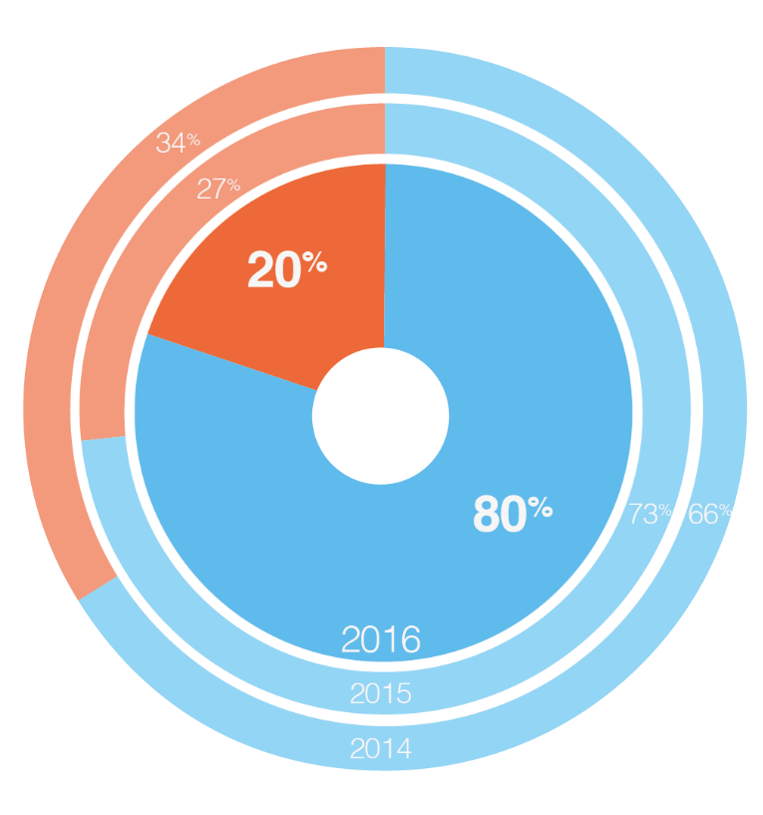
In-App Advertising Domination: A Worldwide Phenomenon
In-App vs. Mobile Web Share of Mobile Ad Spending
In-App vs. Mobile Web Share of Mobile Ad Spending in Top 10 Global Markets
USA
84%
16%
China
99%
1%
UK
84%
16%
Japan
50%
50%
Germany
89%
11%
Australia
81%
19%
South Korea
77%
23%
Canada
87%
13%
Brazil
85%
15%
France
89%
11%
In-App
Mobile Web
Source: Smaato Publisher Platform (SPX), 2014-2016

Slide 10
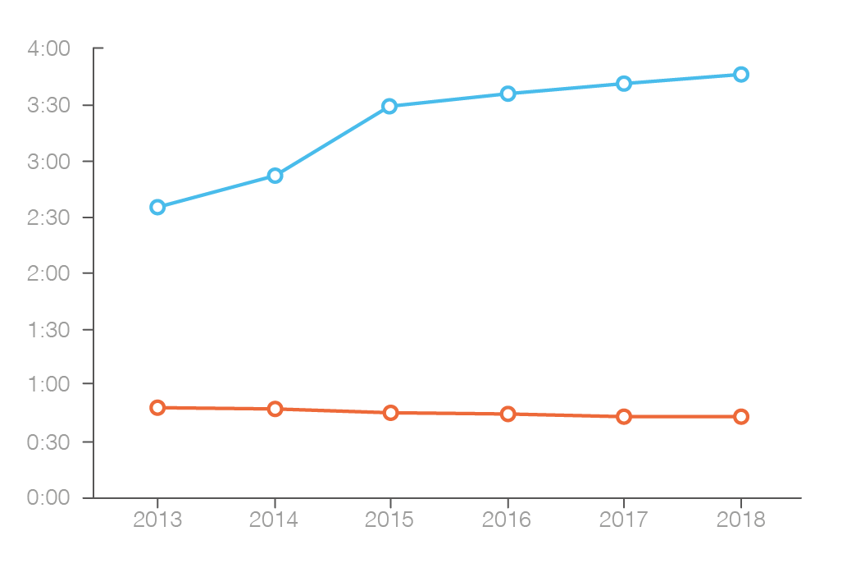
Consumers Spend 85% of Their Time on Smartphones In-App
Share of Average Time Spent per Day In-App vs. Mobile Web
Average Time Spent per Day
In-App vs. Mobile Web (hrs:min)
14.3
%
2016
85.7
%
In-App
Mobile Web
Source: eMarketer, Sep 2016 (among US Smartphone Users)

Slide 11


In-App Advertising is Gamechanger
TV
1950s – 1980s
Internet
1980s – 2010s
Apps
2010 – Present
Mass Audience Tracking
Cookies Track Where Users Go
Device IDs, Smaato ID
& GPS tracking
Can easily be deleted
Not standard across browsers
GPS not super accurate
Where users go
What they do there
What they do over time
„Super-Cookie“
18+ Month Device Tracking

Slide 12

The Building a Unique, Powerful Marketing Tool
Unique capabilities enabled by in-app environment
  18+ months of user tracking and relationship building/data collection to create a reliable, detailed, proprietary user databank for advertisers
  Cross-channel and by-campaign ROI, end-to-end attribution and quick optimization
Sample Database: Each user tracked for 18+ months
Which user IDs have been targeted
Which have responded
Which user IDs have downloaded an app
  Also captures email address for email marketing
  Email addresses useful for cross- device identification
Through usage of app
  Track who visited, how long, where visited
    GPS/Beacons (with Latlong)
    Time stamp
    Visited for how long
  Attributable proof of advertising and channel ROI

Slide 13
Smartphone Lifecycles are Changing
* Urban China ** EU5: Great Britain, France, Germany, Italy, Spain; Source: Kantar Worldpanel

Slide 14





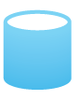

A Consumer’s Journey in a Mobile-First World
VIEWS
BRAND ADS
SEES MOBILE AD NEAR STORE
VISITS STORE AND PURCHASES BRAND/PRODUCT
RETARGETING
BEGINS
USER DATA
USER DATA
Device ID
Device OS
Carrier
Campaign ID
USER
DATA
Age
GPS
Country
Gender
DEVICE ID MATCHING:
18+ MONTHS
INCREASED MARKETING ROI

Slide 15






A Future Hamburg Visitor’s Mobile Journey
Mobile Enables Learning More About the Visitor Every Step of the Way ... And Then Turning That Info into ROI
Receives a Mobile Ad
Target China, Norway, Sweden, Denmark, Germany
Gets on Wifi
at HH Hotspot
Free Wifi in HH Opportunity
Downloads a Hamburg App
- App Marketing
Enjoys Hamburg
Buys tickets
Goes to events
Shops, Etc.
Misses Hamburg
Retargeting based on experience in HH
Visitor Journey
I
Hamburg
Mobile Opportunity
Through Apps
Attract Music Lovers to HH
Email Marketing
Social Media
In-App Marketing (Weather, Travel, Etc.)
Mobile Website Marketing
First Contact and App Marketing
GPS
Zip code
Device ID
Capture Data (with Consent)
Device ID
- Android
- Apple
Age
Gender
Location
More …
Track Usage
(with Consent)
Ticket Purchases
Bike Rental
HVV Usage
Book Hotel
Purchases
Beacons
Follow Over Time and Retarget
18 Months device usage on average
Frequency Cap Per ID Possible
Push Notifications

Slide 16
Advertisers are Recognizing the Value of In-App
Indexed Mobile Web vs In-App eCPM
In-App eCPMs 2x Greater than Mobile Web
2x
Mobile Web
In-App
Source: Smaato Publisher Platform (SPX)

Slide 17
Impressions sold in real-time auctions within 200ms
Smaato’s Real Time Bidding (RTB) Process
SMX
Smaato Global Mobile
RTB Ad Exchange
2. Enriched Bid Request
DSP 1
$0.33
Bid Under Floor Price
3. Bid On Ad Space
1. Ad Request
2. Enriched Bid Request
DSP 2
$1.52
Winning Bid
Second Price Model: $1.32
3. Bid On Ad Space
Location
Device/Carrier/OS
Content Category
Publisher 1st Party Data
App/
Website
Floor Price $1
4. Win Notification
2. Enriched Bid Request
DSP 3
$1.22
DSP Blacklisted
Bid Not Accepted
2. Bid On Ad Space
3. Bid On Ad Space
2. Enriched Bid Request
DSP 4
$1.32
Second Highest Bid
3. Bid On Ad Space
5. Targeted Ad Impression
2. Enriched Bid Request
DSP 5
$0.72
Bid Under Floor Price
6. Ad delivery
3. Bid On Ad Space
200ms
2. Enriched Bid Request
DSP 6
No Bid
No Bid
Enhanced Location
Behavioral
Demographical
App Developers connect to a competitive market which drives more revenue
Advertisers reach a more targeted audience and place per-impression bids
Consumers receive more relevant ads

Slide 18
In-App Advertising:
Big Data – Deep Data

Slide 19
In-App Advertising Creates Deep Data
BIG DATA
1+ Billion
Monthly Mobile Unique Users Globally on the Smaato Platform
DEEP DATA
+
+
+
+
+
+
+
+
+
+
+
Notes:
Big Data/ Deep Data Matrix

Slide 20
Data Explodes as Big Data Meets Deep Data
Quantified Consumer Trend Proliferates
Global Mobile Data Traffic, 2012 - 2020
90% of the world’s data
was created in the
last 2 years
Global Mobile Data Traffic will
Increase 34x
from 2012 - 2020
Source: Cisco VNI Mobile Data Traffic Forecast 2012-2017, Cisco VNI Mobile, 2016

Slide 21
Declining Computing Costs and Advancing Technology
Makes Harnessing Big Data Opportunity Feasible and Affordable
Moore's Law: Over history of computing hardware, number of transistors and integrated circuits doubles every 2 years.
Bezos's Law: Over history of cloud, a unit of computing power price is reduced by 50 percent approximately every 3 years.
Decreasing cost / performance curve enables computational power @ core of digital infrastructure
Compute Costs Declining, 1990-2013
Data in Digital Universe vs. Data Storage Costs, 2010-2015
Source: John Hagel, Deloitte, 5/14
Source: IDC, 5/16
$1,000.00
$527.00
10B
$0.20
$100.00
8B
6B
$0.15
$10.00
$ per 1 MM transaction
Petabytes of Data
Cost per GB of Storage
$1.00
4B
$0.10
$0.10
2B
$0.05
0B
$0.05
$0.00
2010
2011
2012
2013
2014
2015
1990
1992
1994
1996
1998
2000
2002
2004
2006
2008
2010
2012
Data in Digital Universe (Petabytes) Storage Costs ($/GB)
Global Data Growth Rising Fast = +50% CAGR since 2010. Data Infrastructure Costs Falling Fast = -20% CAGR

Slide 22
Vast Majority of Data Coming from Mobile
Specifically from Mobile Apps Because They Generate Deep Data Needed for Prediction
Global Mobile Data Traffic Forecast By Device
12
Other
10
Tablets
8
# of Exabytes per Month
6
Laptops
4
2
Smartphones
0
2012
2013
2014
2015
2016
2017
Source: Cisco VNI Mobile Data Traffic Forecast 2012-2017

Slide 23
In-App Data Enables Morph to Artificial Intelligence
Allows Advertising to Get Ahead of Consumer Behavior
How can we
make it happen?
Prescriptive
What will
Analytics
happen?
Predictive
Why did it
happen?
Analytics
Foresight
alue
What
Diagnostic
V
happened?
Analytics
Descriptive
Insight
Analytics
Hindsight
Di
f
ficulty
Source: Gartner IT Glossary: Predictive Analytics

Slide 24
In-App Advertising: eCPMs & Ad Formats

Slide 25
Indexed eCPM by Ad Format for In-App vs. Mobile Web
Video Ad Types are Most Valued by Advertisers
In-App
Mobile Web
Source: Smaato Publisher Platform (SPX)
Notes:
SAI Feb 2017 Data

Slide 26
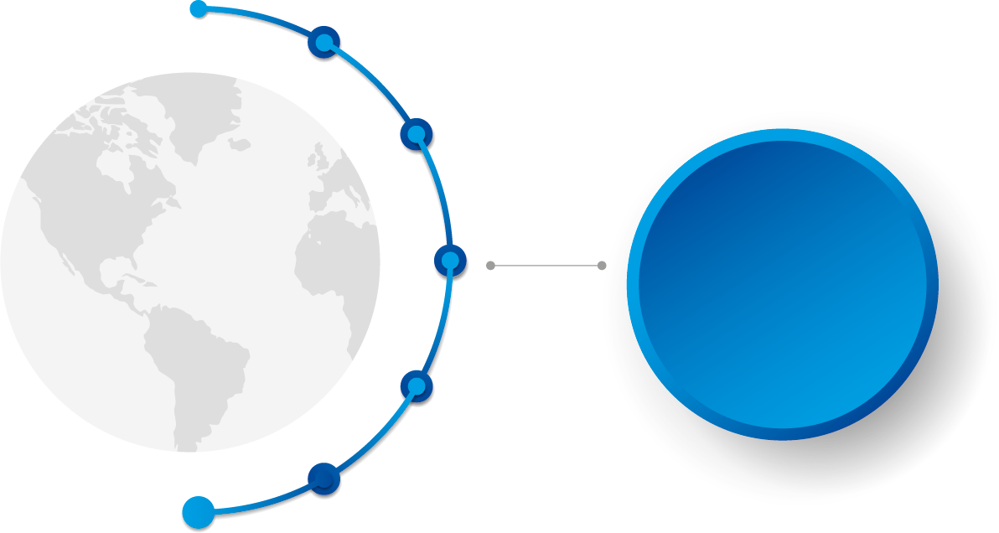
Why the Smartest Mobile Strategies Focus on Video
$6.7
BILLION
will be spent on
mobile video advertising
in 2017
This will account for at least 10% of total US mobile ad spending in 2017

Slide 27
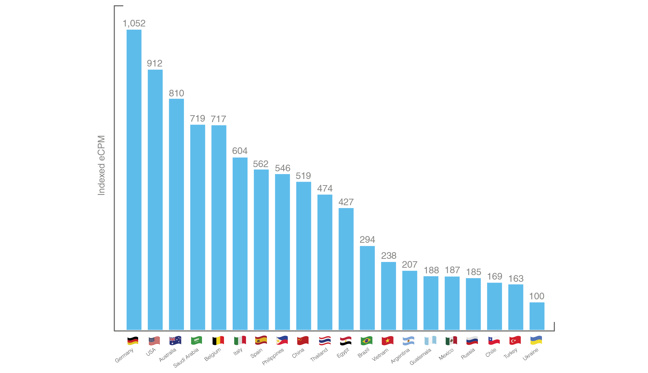
Indexed Mobile Video eCPMs for Top Mobile Video eCPM Countries
Source: Smaato Publisher Platform (SPX) – Q4 2016
Notes:
The

Slide 28
Small Screen Video Drives Big Consumer Impact
Mobile isn't the second or third screen. It's the first.
% of Smartphone Owning 18-34-Year-Olds That Reported Using
Each Device to Watch Video Content in Daily Video Hours
Mobile video viewing is less distracted.
      Millennials are 2X more likely to be focused
      while watching video on mobile than while viewing it on TV.
Notes:
https://blog.hubspot.com/marketing/video-marketing-statistics#sm.0019t9o6m18rod5hujd2jvmiux0ma

Slide 29
Video Engages and Converts
90% of users say that product videos are helpful in decision process
64% of users are more likely to buy a product online after watching a video
80% of users recall a video ad they viewed in the past 30 days
Real Estate listings that include a video receive 403% more inquieries than those without
The average user is exposed to an average
32.3 videos in a month
92% of mobile video consumers share videos with others
Notes:
https://blog.hubspot.com/marketing/video-marketing-statistics#sm.0019t9o6m18rod5hujd2jvmiux0ma

Slide 30

Why Mobile Video Needs to Be Part of Your Strategy
The Mobile Video Sweet Spot
What does
my audience care about?
What does my brand stand for?
Where does my audience discover?
Notes:
https://www.thinkwithgoogle.com/articles/youtube-insights-stats-data-trends-vol6.html
https://www.thinkwithgoogle.com/articles/online-video-mobile-marketing-strategy.html
http://tubularinsights.com/mobile-video-marketing-strategy-fortune-50/
Who is Watching, and Engaging with Your Mobile Video Content?
Although Fortune 50 companies can afford to advertise on television, their target viewers are watching as much video online as they’re watching on TV. And, according Nielsen’s analysis, which was commissioned by Google, 18-49 year-olds’ time on YouTube jumped 44% last year due primarily to mobile viewership even as time in front of the TV declined.
However, as I mentioned just last week, consumer intent can help you reach more of your target audience than demographics alone – especially if consumers are mobile shoppers. For example, an analysis of mobile search and video behavior by Millward Brown Digital found that only 31% of mobile searchers for video games are men ages 18 to 34.
To make this point perfectly clear, the YouTube Advertisers channel has even created a video entitled, “What Do You Really Know About Gamers?”
But the video game market isn’t the exception to the rule. A 2015 study by Google/Ipsos MediaCT found that 40% of baby product consumers actually live in homes without children! This is also true for 52% of baby product influencers. Who are these people? Well, they could be grandparents, cousins, friends, or co-workers. And their #1 way of finding out about these baby and children products is via a search engine – whether that’s Google, or YouTube. In other words, search is social.
Source: Mobile Video Marketing Strategy for Fortune 50 Brands http://tubularinsights.com/mobile-video-marketing-strategy-fortune-50/#ixzz4ZoLiiySk
©TubularInsights.com, All Rights Reserved

Slide 31
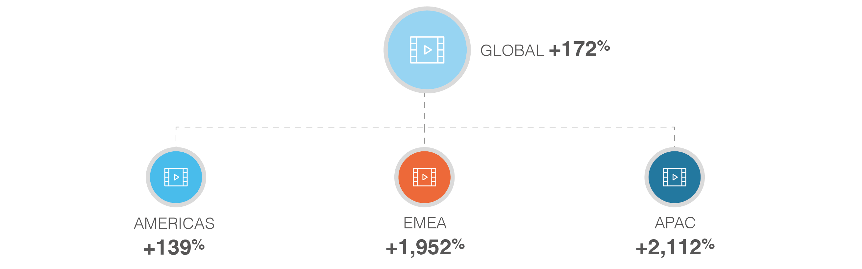
Mobile Video Ad Spending Skyrockets in Q4
Global and Regional Mobile Video Ad Spend Growth
Q4 2016 vs. Q3 2016
Source: Smaato Publisher Platform (SPX) – 2014 - 2016

Slide 32








Smart Video Strategy: Outstream Video
A video advertising unit - typically within text content - that autoplays in a player
only when a user navigates to the ad unit section.
Other Names: In-Read, In-Article, In-Line or In-Page
Intent:
Highly engaging since the user controls whether he wants to watch the video or not
Technology:
VAST +JS player designed
for Mobile
Tracking:
Quartile / VTR etc.
Placement:
In-App & Mobile Websites
Viewability:
Top scores, since the video loads and plays only when 70% or more visible
Price:
Medium - High Range
​Copyright © 2017 Smaato Inc. All Rights Reserved.

Slide 33




Outstream vs. Instream: What‘s The Difference?
Instream
Outstream
Classic video ad format known from classic media such as TV (pre-roll, mid-roll, post-roll)
Runs only within video content and thus limited by availability of such content
Video ad format which typically plays within static text content outside of video content
Expands inventory available for video ads
Loads and plays only when 70% or more is visible to consumer
​Copyright © 2017 Smaato Inc. All Rights Reserved.

Slide 34

Interstitial Video
Full-screen video ads that appear between two content pages
Other Names: Transition Ads, Intermercial Ads and Splash Pages
User Experience
Intrusive because full-screen but skippable-Sound Auto
Technology
Vast Standard
Tracking:
Quartile/VTR etc.
Placement
In-App
Viewability:
Mostly 100%
because full-screen
Price
Medium Range
​Copyright © 2017 Smaato Inc. All Rights Reserved.

Slide 35


Smart Video Strategy: Rewarded Video
Ads that users are rewarded with virtual in-app currency for watching.
Other Names: Incentivized Video
Engagement
Forced ad experience,
Non-Skippable
Technology
Vast Standard
Tracking
Quartile / VTR etc.
Placement
In-App Games
Viewability
100%
(Non-skippable)
and full-screen
Price
Medium Range
​Copyright © 2017 Smaato Inc. All Rights Reserved.

Slide 36

Examples of Rewarded Video Ad Types
Intuitive Ad
Selective Show Ad
Scaled Reward Ad
Adapts introduction of ad into gameplay
Only shows ad at selected/irregular times
Increases rewards as player progresses
Energy Change Ads
Strategic Capping
Shows ads early in game to give player early boost
Limits rewards per session or award duration
Ad Source: DeltaDNA Blog

Slide 37
Making Most of Rewarded Ads
Intuitively incorporate into gameplay to enhance player experience
Choose timing carefully – make offer feel special by showing selectively
Tie offers into energy mechanics of game – get player off to fast start or boost mid-game slump
Scale offer up in value as player progresses through game – encourage player to keep playing
Rewarded video ad strategy should enhance game monetization – make sure offers are limited to motivate in-app purchases
Notes:
https://deltadna.com/blog/rewarded-video-ads-in-mobile-games/

Slide 38


Smart ROI Video Strategies: Leverage Outstream Video
66% of media professionals agree that Outstream provides them access to additional premium inventory for video content - eMarketer
Provides better SCALE
43% of brand professionals agree that Outstream increases brand awareness better than other ad formats - Teads
Increases brand AWARENESS
Provides higher CONVERSIONS
59% of media professionals cite that Outstream delivers better them ROI than other ad formats - eMarketer
ROI @ Scale
​Copyright © 2017 Smaato Inc. All Rights Reserved.

Slide 39
Summary

Slide 40
The Mobile Opportunity to Revolutionize Marketing
Mobile & In-App opens up new marketing opportunities not previously possible.
Mobile makes consumers reliably addressable and trackable at scale in ways never before possible.
The Mobile Advantage: Scale, Tracking and Attribution
  Scale: Huge common global penetration uniquely makes global target audiences addressable at scale
  Tracking: In-app environment allows better and more reliable tracking that creates possibilities no previous technology could deliver.
  Attribution: Enables marketing performance measurement not previously possible with end-to-end attribution and ROI.
Better Consumer Experience: Vastly improved marketing engagement and information relevance.
Notes:
Mobile Opportunity

Slide 41
Thank you
Ragnar Kruse
CEO & Co-Founder

